Slide 1
Name :Joan Joshy
Branch of Study :Electronics and Communication Engineering
Year of Study :3rd Year (6th Semester)
College :Govt. Model Engineering College, Kochi
EmailId :joanjoshy.mec@gmail.com
Internship Title :Smart Agriculture system based on IoT - SB37013
Project ID :SPS_PRO_101

Slide 2
Smart Agriculture System based on IoT
By: Joan Joshy
Project ID: SPS_PRO_101
Internship Title: Smart Agriculture system based on IoT - SB37013

Slide 3
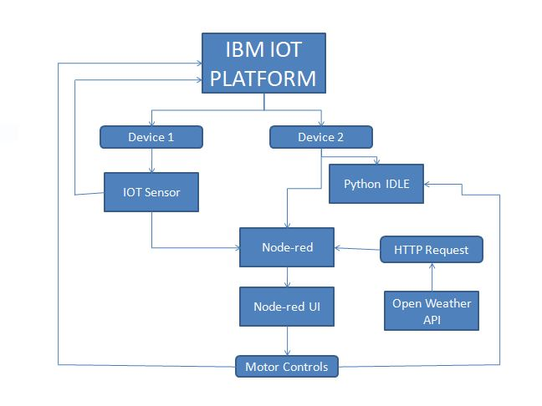
BLOCK DIAGRAM

Slide 4
Smart Agriculture System based on IoT
The automated irrigation system implemented was found to be feasible and cost effective for optimizing water resources for agriculture production. This irrigation system allows cultivation in places with water scarcity thereby improving sustainability. The irrigation system helps the farmer by making his work smarter. As the demand for water increases, along with the need to protect aquatic habitats, water conservation practices for irrigation need to be effective and affordable. As multiple sensors are used, water can be provided only to the required area of land. This system reduces the water consumption to greater extent. It needs minimal maintenance. The power consumption has been reduced very much. The crop productivity increases and the wastage of crops are very much reduced.

Slide 5
Thank You.

